Slide 1

Automatic Machine Learning (AutoML): A Tutorial
Frank Hutter
University of Freiburg
fh@cs.uni-freiburg.de
Joaquin Vanschoren
Eindhoven University of Technology
j.vanschoren@tue.nl
Slides available at automl.org/events -> AutoML Tutorial
(all references are clickable links)

Slide 2
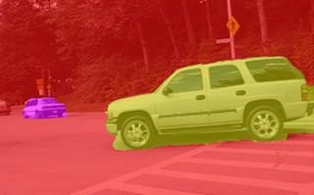
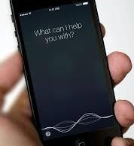
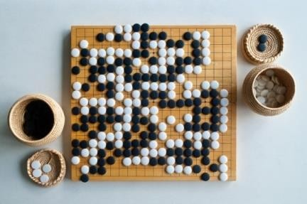
Motivation: Successes of Deep Learning
Computer vision in self-driving cars
Speech recognition
Reasoning in games

Slide 3






















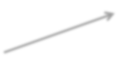







One Problem of Deep Learning
Performance is very sensitive to many hyperparameters
Architectural hyperparameters
Units per layer
dog
cat
…
Kernel size
# convolutional layers # fully connected layers
Optimization algorithm, learning rates, momentum,
batch normalization, batch sizes, dropout rates, weight decay,
data augmentation, …
→ Easily 20-50 design decisions

Slide 4

Deep Learning and AutoML
Current deep learning practice
Expert chooses architecture & hyperparameters
Deep learning
“end-to-end”
AutoML: true end-to-end learning
Meta-level
learning & optimization
Learning
box
End-to-end learning

Slide 5

Learning box is not restricted to deep learning
Traditional machine learning pipeline:
Clean & preprocess the data
Select / engineer better features
Select a model family
Set the hyperparameters
Construct ensembles of models
– …
AutoML: true end-to-end learning
Meta-level
learning & optimization
Learning
box
End-to-end learning

Slide 6
Outline
Modern Hyperparameter Optimization
Neural Architecture Search
Meta Learning
For more details, see: automl.org/book
AutoML: true end-to-end learning
Meta-level
learning & optimization
Learning
box
End-to-end learning

Slide 7

Outline
1. Modern Hyperparameter Optimization
AutoML as Hyperparameter Optimization
Blackbox Optimization
Beyond Blackbox Optimization
Based on: Feurer & Hutter: Chapter 1 of the AutoML book: Hyperparameter Optimization
2. Neural Architecture Search
Search Space Design Blackbox Optimization
Beyond Blackbox Optimization

Slide 8
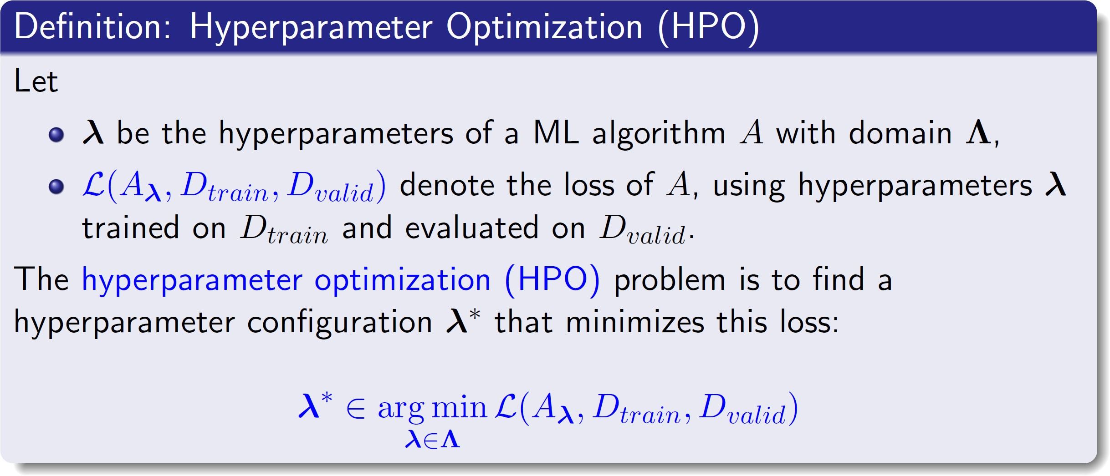
Hyperparameter Optimization

Slide 9
Types of Hyperparameters
Continuous
Example: learning rate
Integer
Example: #units
Categorical
Finite domain, unordered
Example 1: algo ∈ {SVM, RF, NN}
Example 2: activation function ∈ {ReLU, Leaky ReLU, tanh} Example 3: operator ∈ {conv3x3, separable conv3x3, max pool, …}
Special case: binary

Slide 10
Conditional hyperparameters
Conditional hyperparameters B are only active if other hyperparameters A are set a certain way
Example 1:
A = choice of optimizer (Adam or SGD)
B = Adam‘s second momentum hyperparameter (only active if A=Adam)
Example 2:
A = type of layer k (convolution, max pooling, fully connected, ...) B = conv. kernel size of that layer (only active if A = convolution)
Example 3:
A = choice of classifier (RF or SVM)
B = SVM‘s kernel parameter (only active if A = SVM)

Slide 11
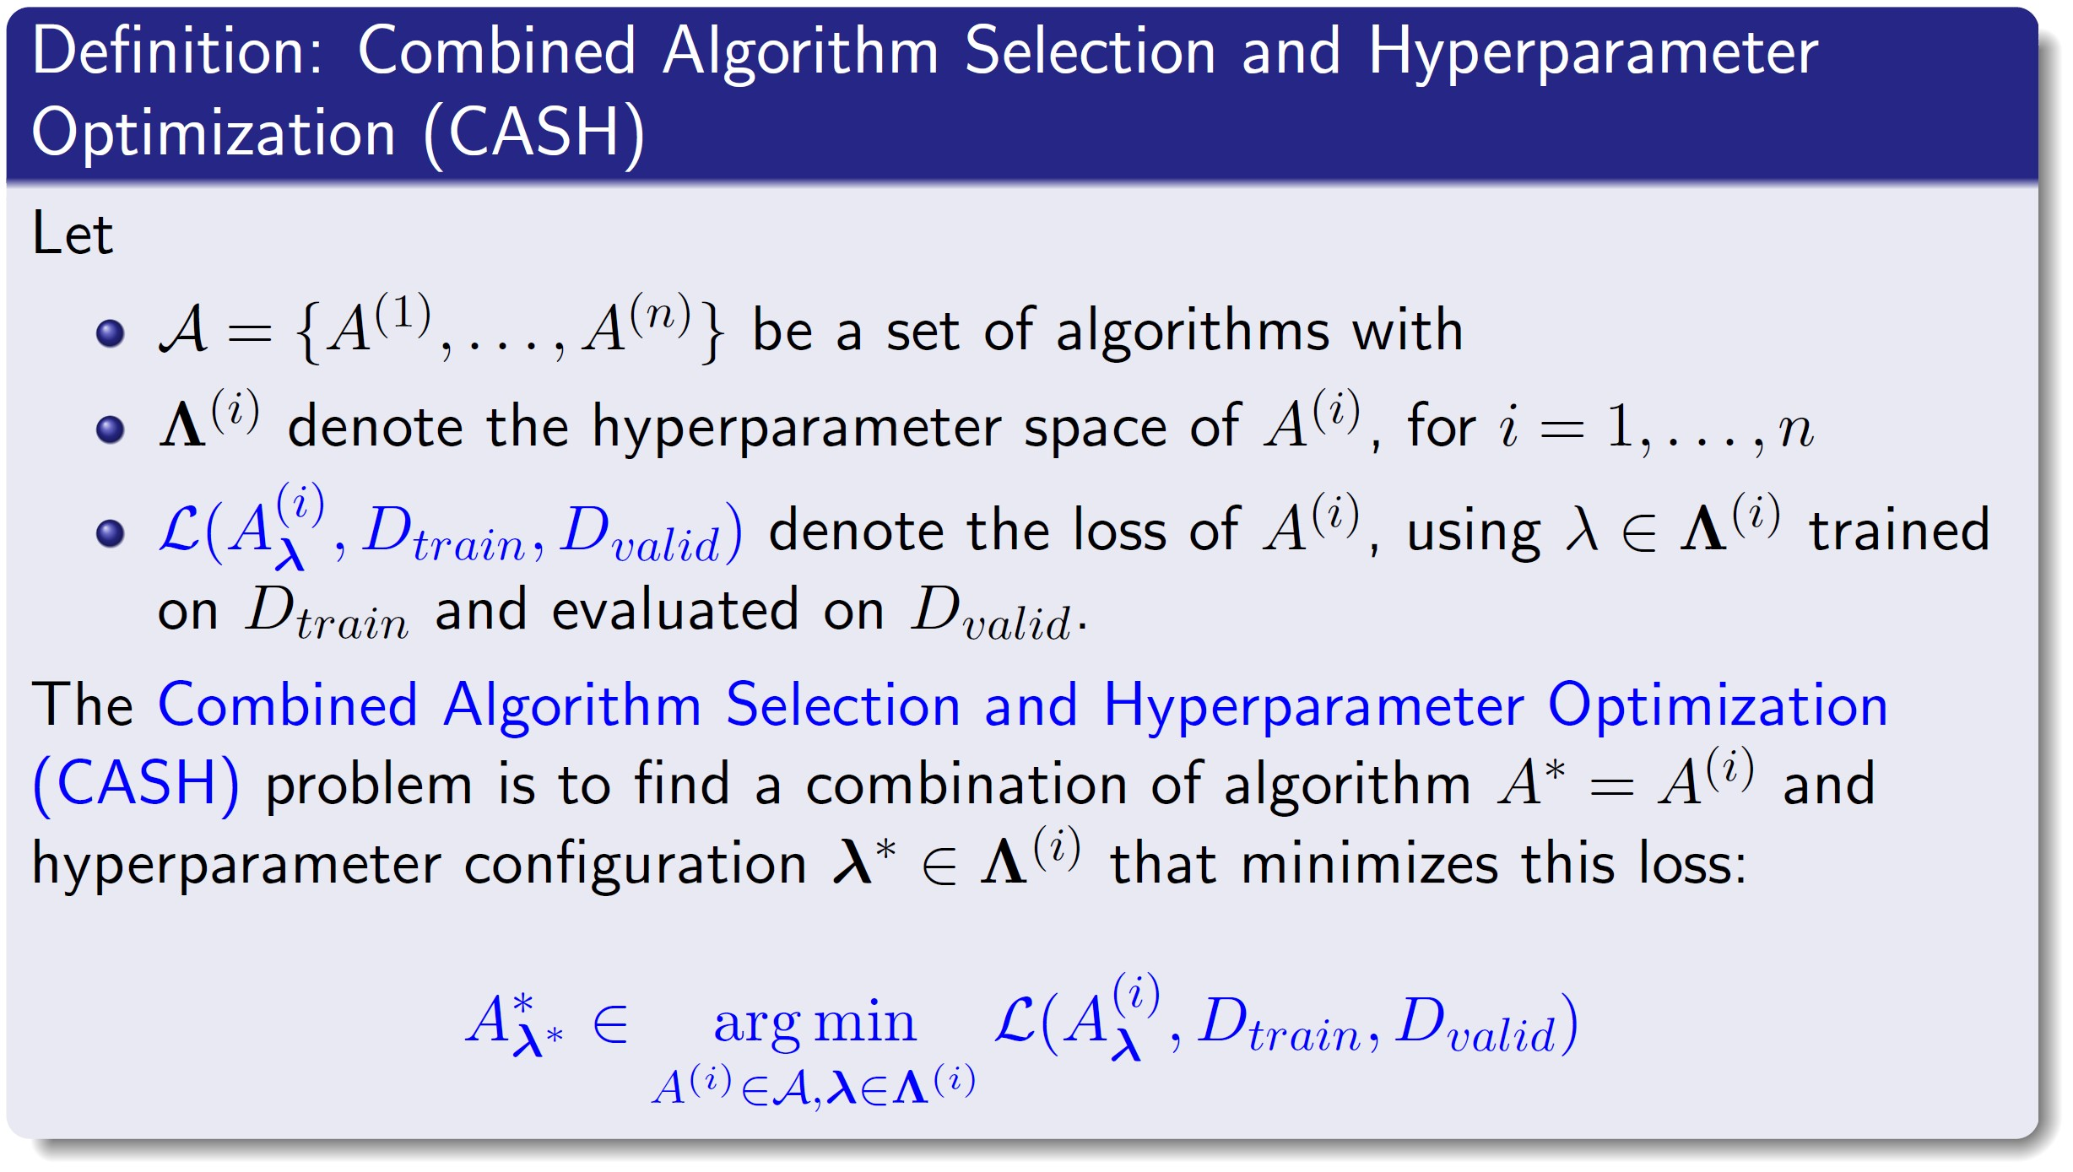

AutoML as Hyperparameter Optimization
Simply a HPO problem with a top-level hyperparameter (choice of algorithm)
that all other hyperparameters are conditional on
- E.g., Auto-WEKA: 768 hyperparameters, 4 levels of conditionality

Slide 12
Outline
1. Modern Hyperparameter Optimization
Blackbox Optimization
AutoML as Hyperparameter Optimization
Beyond Blackbox Optimization
2. Neural Architecture Search
Search Space Design Blackbox Optimization
Beyond Blackbox Optimization

Slide 13
Blackbox Hyperparameter Optimization
DNN hyperparameter setting 𝝀
Train DNN
and validate it
Validation performance f(𝝀)
Blackbox optimizer
max f(𝝀)
𝝀∈𝜦
The blackbox function is expensive to evaluate
→ sample efficiency is important

Slide 14
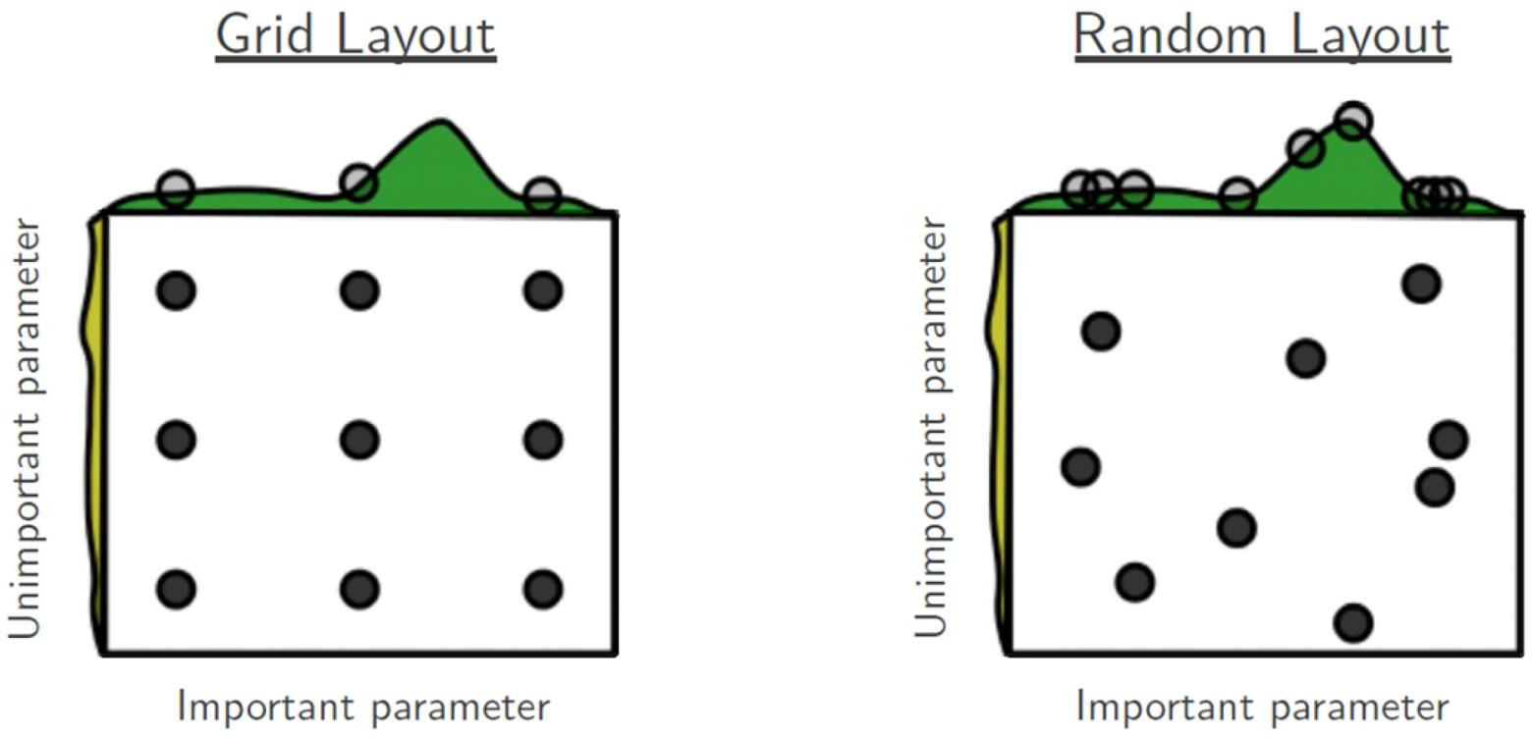
Grid Search and Random Search
Both completely uninformed
Random search handles unimportant dimensions better Random search is a useful baseline
Image source: Bergstra & Bengio, JMLR 2012

Slide 15
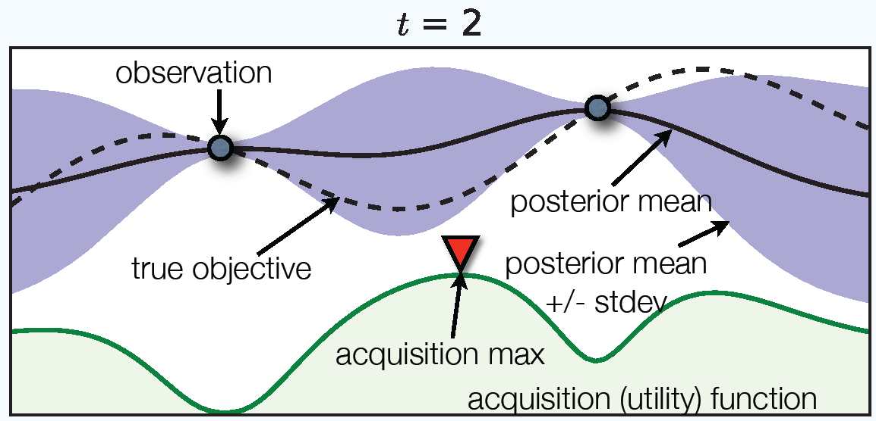
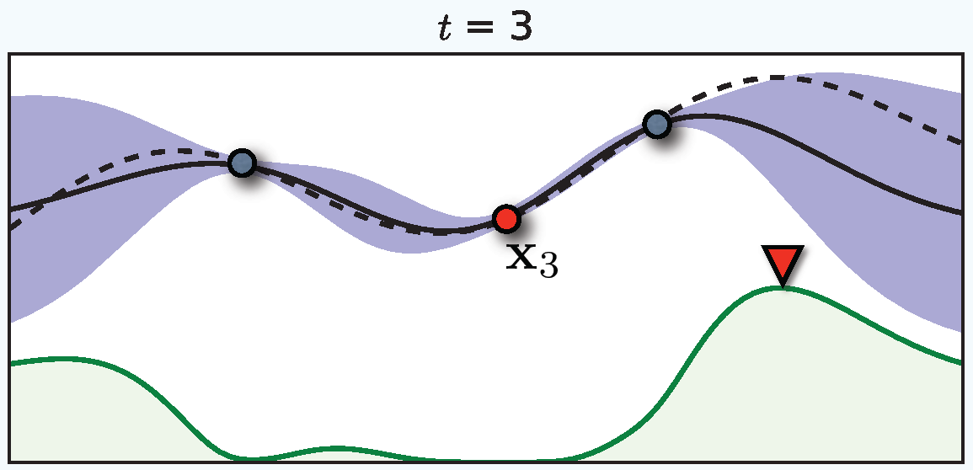
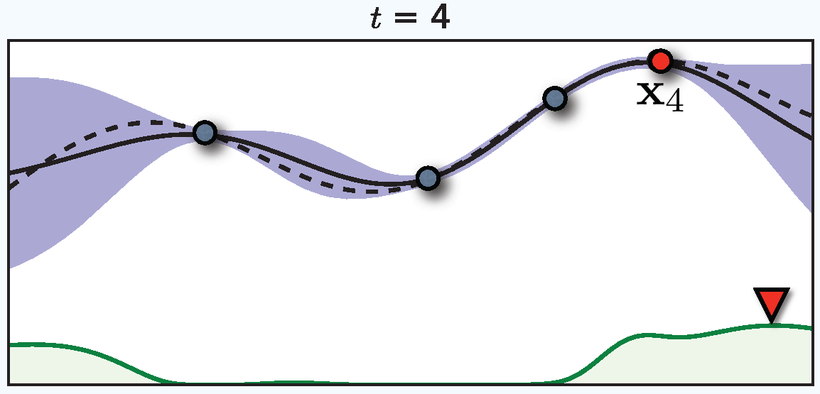
Bayesian Optimization
Approach
Fit a proabilistic model to the function evaluations 〈𝜆, 𝑓 𝜆 〉
Use that model to trade off exploration vs. exploitation
Popular since Mockus [1974]
Sample-efficient
Works when objective is nonconvex, noisy, has unknown derivatives, etc
Recent convergence results
[Srinivas et al, 2010; Bull 2011; de Freitas et al, 2012; Kawaguchi et al, 2016]
Image source: Brochu et al, 2010

Slide 16
Example: Bayesian Optimization in AlphaGo
[Source: email from Nando de Freitas, today; quotes from Chen et al, forthcoming]
During the development of AlphaGo, its many hyperparameters were tuned with Bayesian optimization multiple times.
This automatic tuning process resulted in substantial improvements in playing strength. For example, prior to the match with Lee Sedol, we tuned the latest AlphaGo agent and this improved its win-rate from 50% to 66.5% in self-play games. This tuned version was deployed in the final match.
Of course, since we tuned AlphaGo many times during its development cycle, the compounded contribution was even higher than this percentage.

Slide 17
AutoML Challenges for Bayesian Optimization
Problems for standard Gaussian Process (GP) approach:
Complex hyperparameter space
High-dimensional (low effective dimensionality) [e.g., Wang et al, 2013] Mixed continuous/discrete hyperparameters [e.g., Hutter et al, 2011] Conditional hyperparameters [e.g., Swersky et al, 2013]
Noise: sometimes heteroscedastic, large, non-Gaussian
Robustness (usability out of the box)
Model overhead (budget is runtime, not #function evaluations)
Simple solution used in SMAC: random forests [Breiman, 2001]
Frequentist uncertainty estimate:
variance across individual trees’ predictions [Hutter et al, 2011]

Slide 18
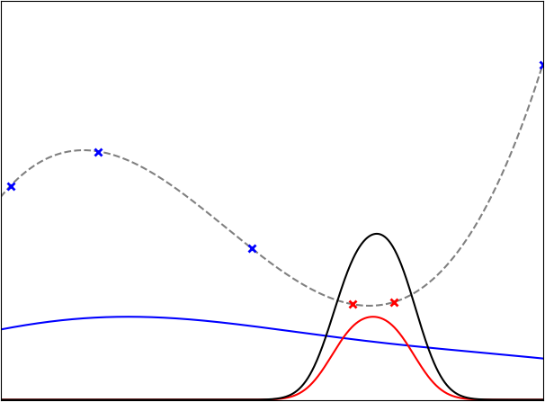
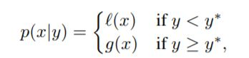
Tree of Parzen Estimators (TPE)
[Bergstra et al, NIPS 2011]
Non-parametric KDEs for p(𝜆 is good)
and p(𝜆 is bad), rather than p(y|λ)
Equivalent to expected improvement
Pros:
Efficient: O(N*d)
Parallelizable
Robust
Cons:
Less sample- efficient than GPs

Slide 19
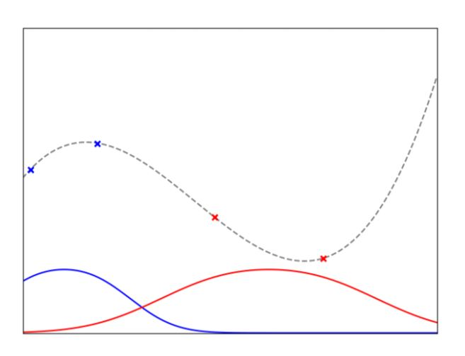
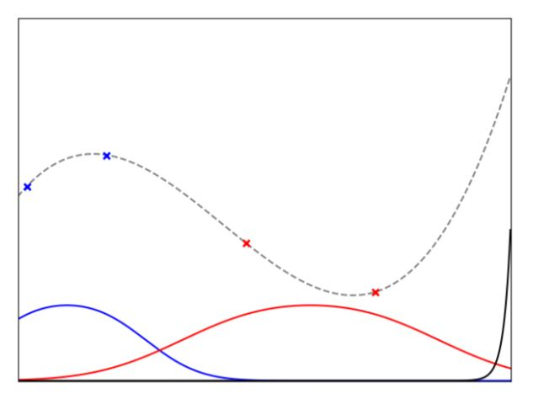
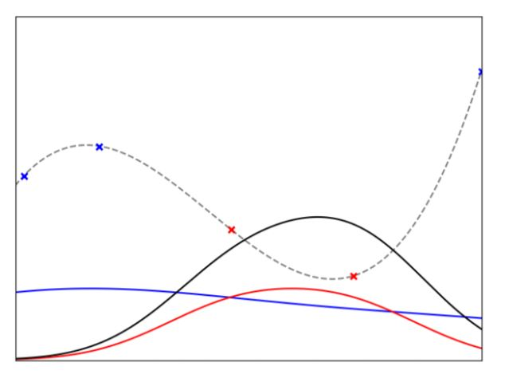
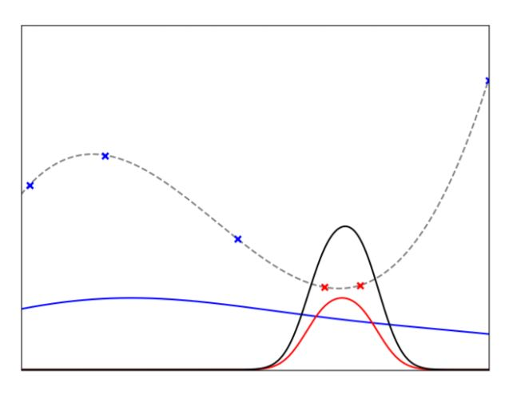
Tree of Parzen Estimators (TPE)

Slide 20
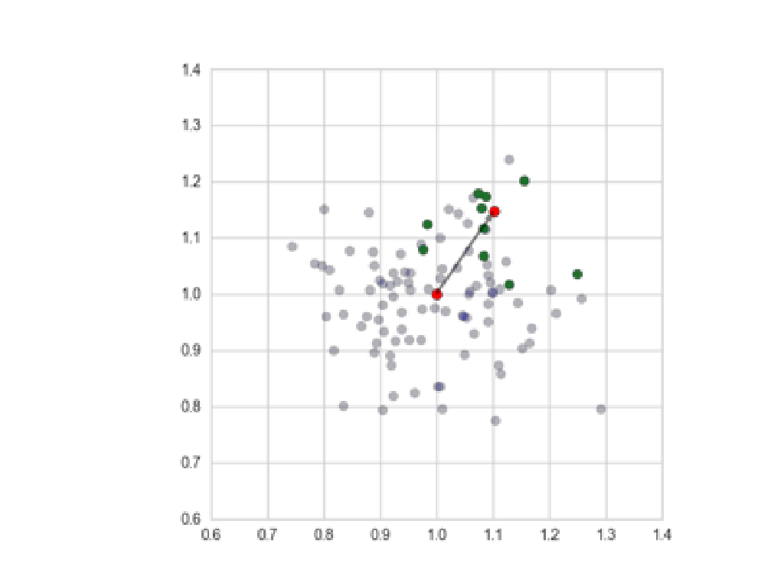
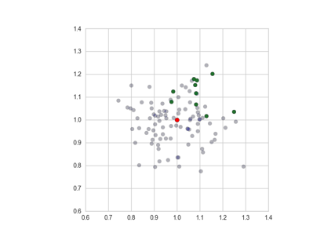
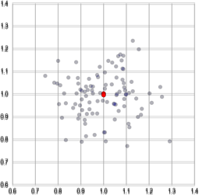
Population-based Methods
Population of configurations
Maintain diversity
Improve fitness of population
g, evolutionary strategies
Book: Beyer & Schwefel [2002]
Popular variant: CMA-ES [Hansen, 2016]
Very competitive for HPO of deep neural nets [Loshchilov & Hutter, 2016]
Embarassingly parallel Purely continuous

Slide 21
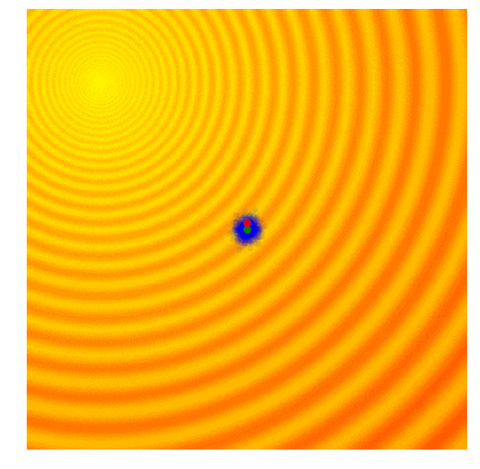
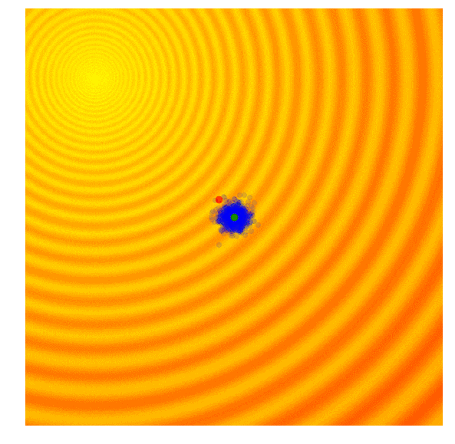
Evolutionary Strategies(ES)

Slide 22
Outline
1. Modern Hyperparameter Optimization
AutoML as Hyperparameter Optimization
Blackbox Optimization
Beyond Blackbox Optimization
2. Neural Architecture Search
Search Space Design Blackbox Optimization
Beyond Blackbox Optimization

Slide 23
Beyond Blackbox Hyperparameter Optimization
DNN hyperparameter setting 𝝀
Train DNN
and validate it
Validation performance f(𝝀)
Blackbox optimizer
max f(𝝀)
𝝀∈𝜦
Too slow for DL / big data

Slide 24
Main Approaches Going Beyond Blackbox HPO
Hyperparameter gradient descent
Extrapolation of learning curves Multi-fidelity optimization
Meta-learning [part 3 of this tutorial]

Slide 25
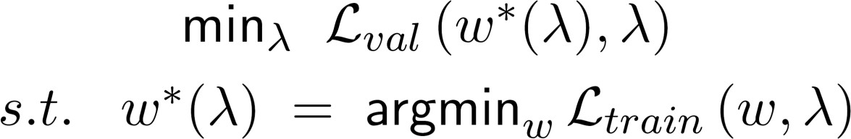
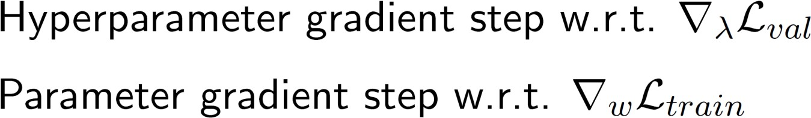
Hyperparameter Gradient Descent
Formulation as bilevel optimization problem
[e.g., Franceschi et al, ICML 2018]
Derive through the entire optimization process
[MacLaurin et al, ICML 2015]
Interleave optimization steps [Luketina et al, ICML 2016]

Slide 26
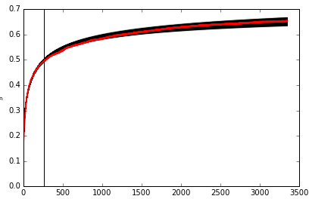
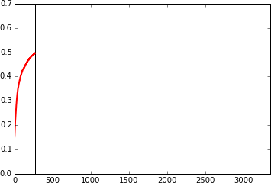
Probabilistic Extrapolation of Learning Curves
Parametric learning curve models [Domhan et al, IJCAI 2015]
Bayesian neural networks [Klein et al, ICLR 2017]

Slide 27
Multi-Fidelity Optimization
Use cheap approximations of the blackbox, performance on which correlates with the blackbox, e.g.
Subsets of the data
Fewer epochs of iterative training algorithms (e.g., SGD)
Shorter MCMC chains in Bayesian deep learning
Fewer trials in deep reinforcement learning
Downsampled images in object recognition
Also applicable in different domains, e.g., fluid simulations:
Less particles Shorter simulations

Slide 28
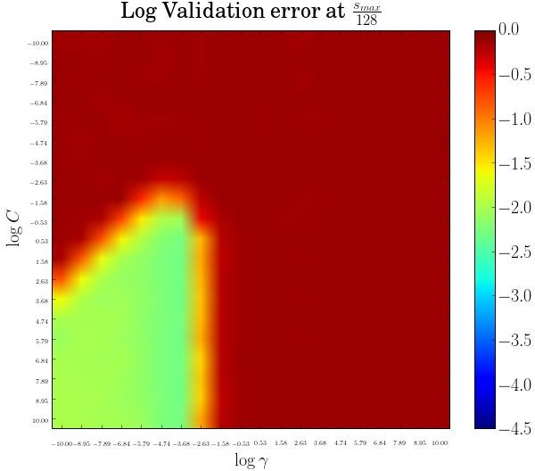
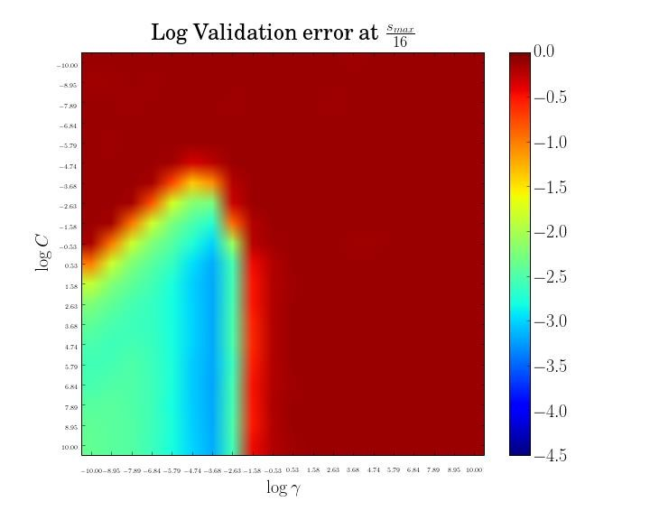
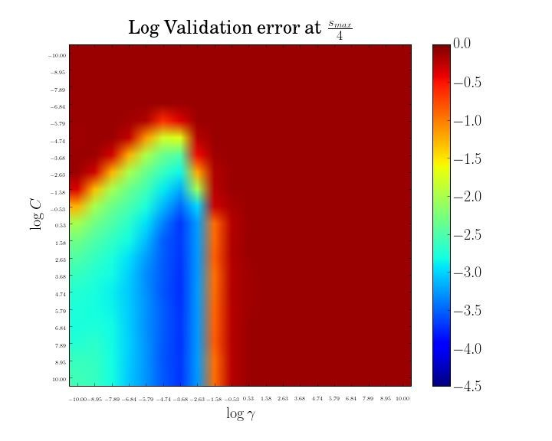
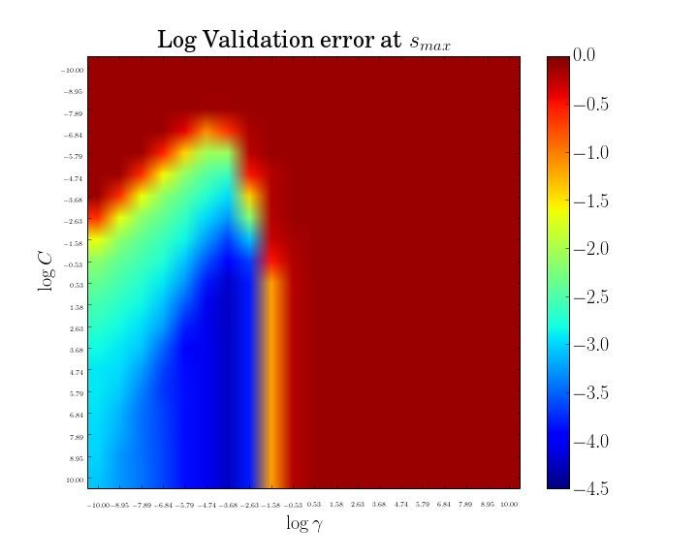
Multi-fidelity Optimization
Make use of cheap low-fidelity evaluations
– E.g.: subsets of the data (here: SVM on MNIST)
log(C)
log(C)
log(C)
log(C)
log(γ)
log(γ)
log(γ)
log(γ)
Size of subset (of MNIST)
Many cheap evaluations on small subsets
Few expensive evaluations on the full data
Up to 1000x speedups [Klein et al, AISTATS 2017]

Slide 29
Multi-fidelity Optimization
Make use of cheap low-fidelity evaluations
– E.g.: subsets of the data (here: SVM on MNIST)
× ×
×× ×
×
×
×
×
×
×
×
× ×
log(C)
× ×
× ×
log(C)
×
×
log(C)
log(C)
×
×
×
× × × ×
×
×
×
×
×
×
× ×
×
× ×
log(γ)
×
×
log(γ)
log(γ) log(γ)
Size of subset (of MNIST)
Fit a Gaussian process model f(λ,b) to predict performance as a function of hyperparameters λ and budget b
Choose both λ and budget b to maximize “bang for the buck” [Swersky et al, NIPS 2013; Swersky et al, arXiv 2014;
Klein et al, AISTATS 2017; Kandasamy et al, ICML 2017]

Slide 30
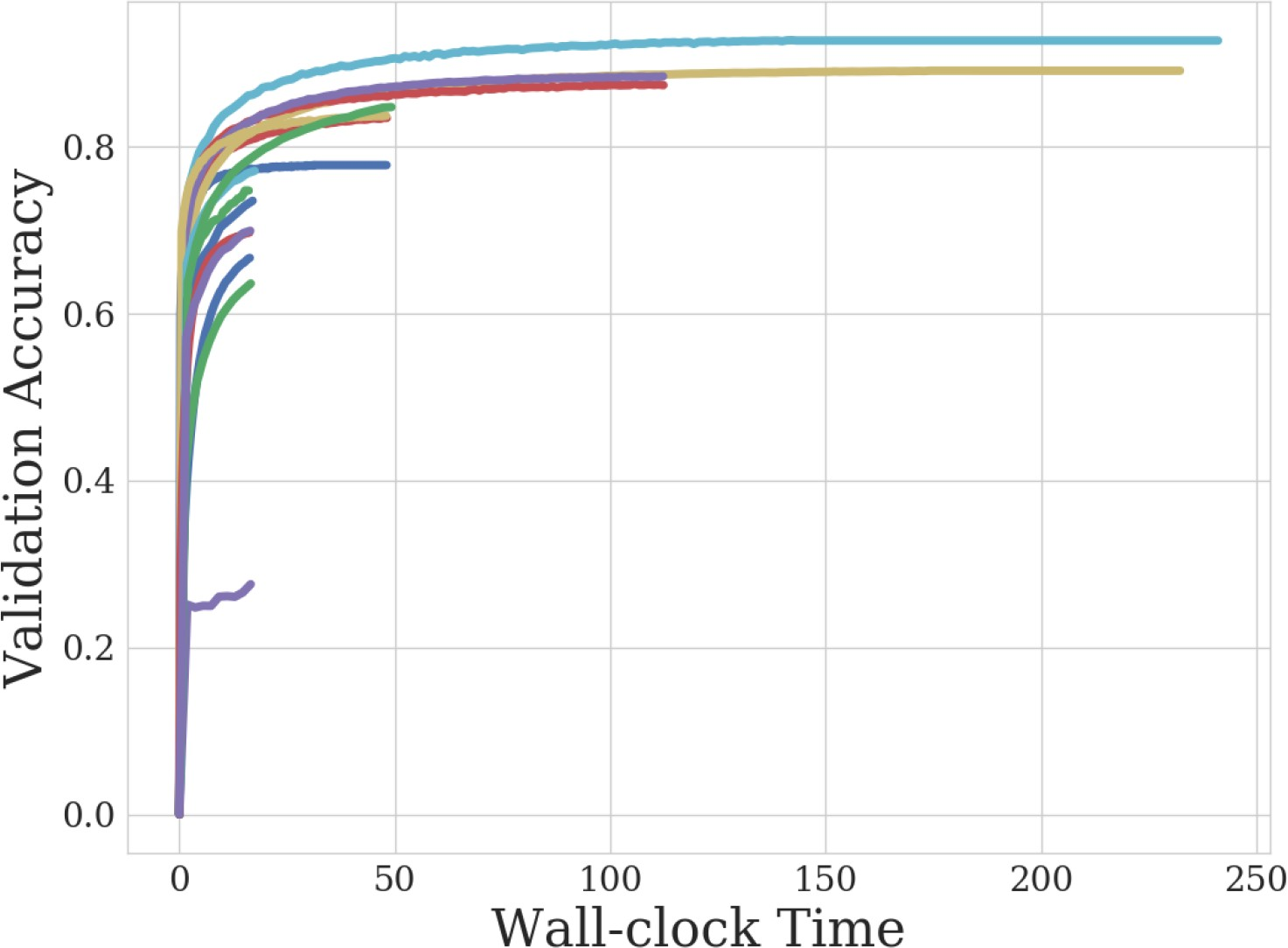
A Simpler Approach: Successive Halving (SH)
[Jamieson & Talwalkar, AISTATS 2016]

Slide 31
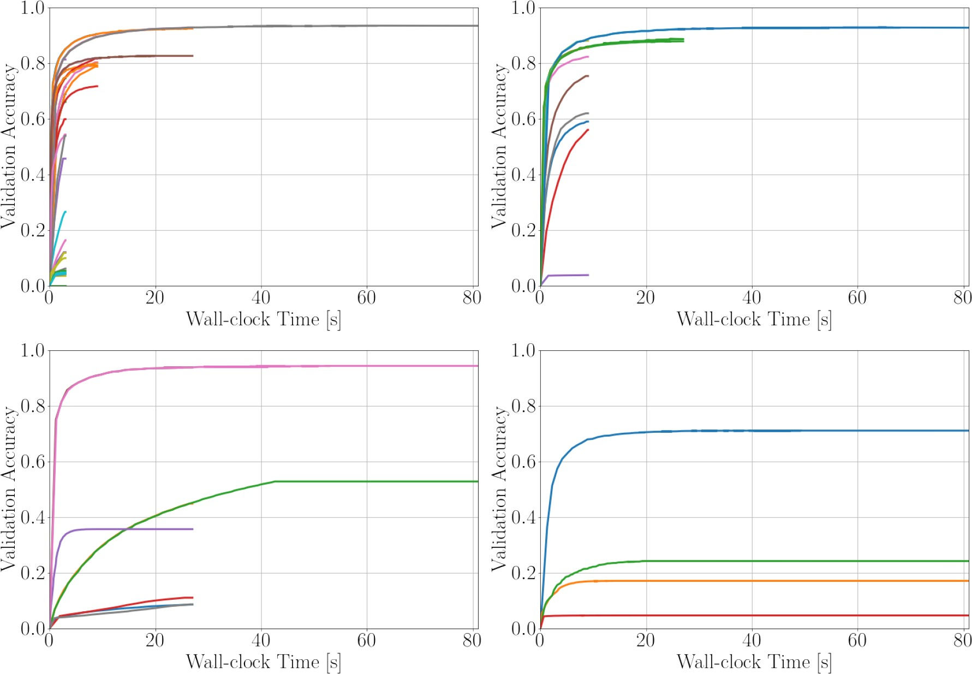
Hyperband (its first 4 calls to SH)
[Li et al, ICLR 2017]

Slide 32
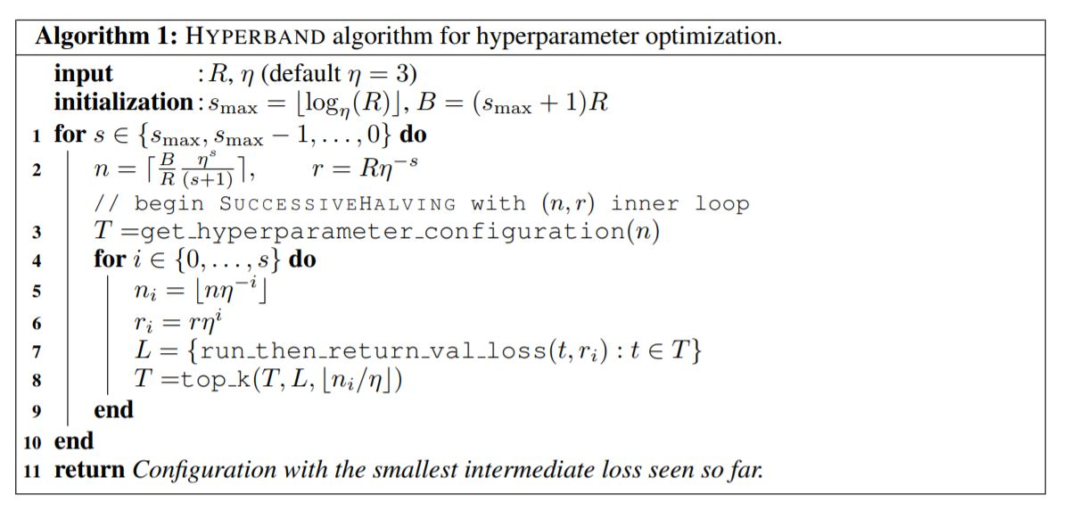
Hyperband Algorithm

Slide 33
BOHB: Bayesian Optimization & Hyperband
[Falkner, Klein & Hutter, ICML 2018]
Advantages of Hyperband
Strong anytime performance
General-purpose
Low-dimensional continuous spaces
High-dimensional spaces with conditionality, categorical dimensions, etc
Easy to implement
Scalable
Easily parallelizable
Advantage of Bayesian optimization: strong final performance
Combining the best of both worlds in BOHB
Bayesian optimization
for choosing the configuration to evaluate (using a TPE variant)
Hyperband
for deciding how to allocate budgets

Slide 34
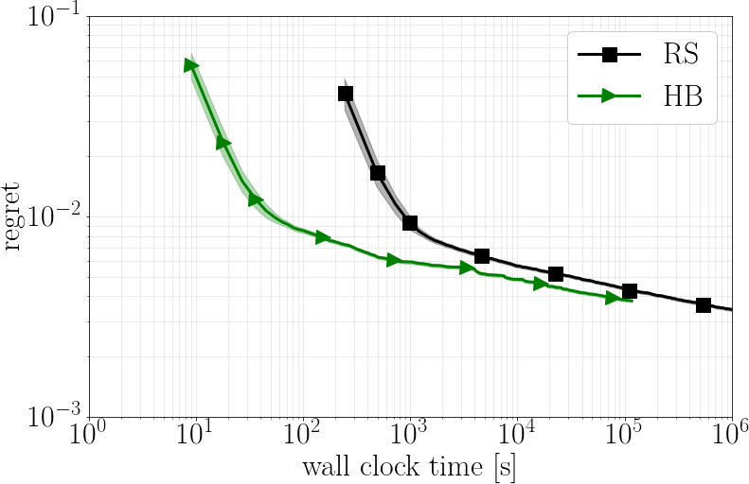
Hyperband vs. Random Search
20x speedup
3x speedup
Biggest advantage: much improved anytime performance
Auto-Net on dataset adult

Slide 35
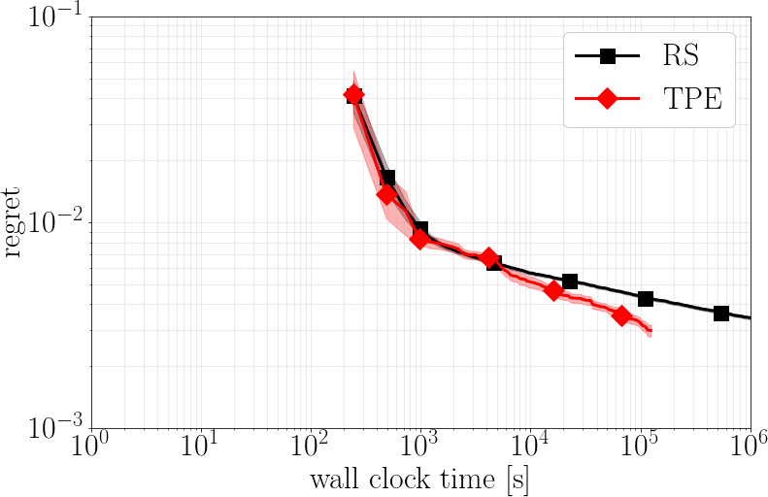
Bayesian Optimization vs Random Search
no speedup (1x)
10x speedup
Biggest advantage: much improved final performance
Auto-Net on dataset adult
Hutter & Vanschoren: AutoML

Slide 36
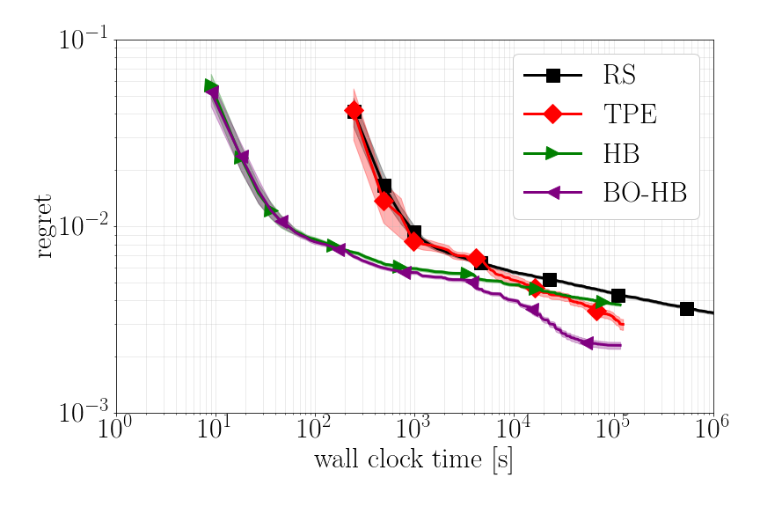
Combining Bayesian Optimization & Hyperband
20x speedup
50x speedup
Best of both worlds: strong anytime and final performance
Auto-Net on dataset adult
34

Slide 37
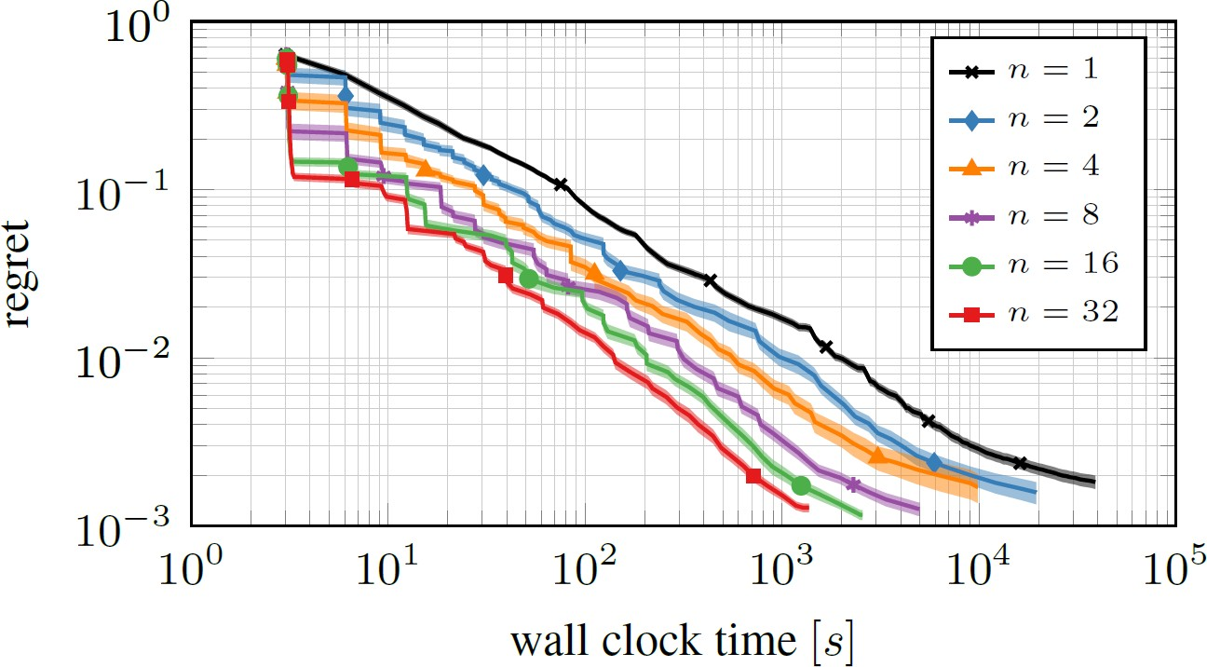
Almost Linear Speedups By Parallelization
Auto-Net on dataset letter

Slide 38
HPO for Practitioners: Which Tool to Use?
If you have access to multiple fidelities
We recommend BOHB [Falkner et al, ICML 2018]
https://github.com/automl/HpBandSter
Combines the advantages of TPE and Hyperband
If you do not have access to multiple fidelities
Low-dim. continuous: GP-based BO (e.g., Spearmint)
High-dim, categorical, conditional: SMAC or TPE
Purely continuous, budget >10x dimensionality: CMA-ES

Slide 39
Open-source AutoML Tools based on HPO
Auto-WEKA [Thornton et al, KDD 2013]
768 hyperparameters, 4 levels of conditionality
Based on WEKA and SMAC
Hyperopt-sklearn [Komer et al, SciPy 2014]
Based on scikit-learn & TPE
Auto-sklearn [Feurer al, NIPS 2015]
Based on scikit-learn & SMAC / BOHB
Uses meta-learning and posthoc ensembling
Won AutoML competitions 2015-2016 & 2017-2018
TPOT [Olson et al, EvoApplications 2016]
Based on scikit-learn and evolutionary algorithms
H2O AutoML [so far unpublished]
Based on random search and stacking

Slide 40

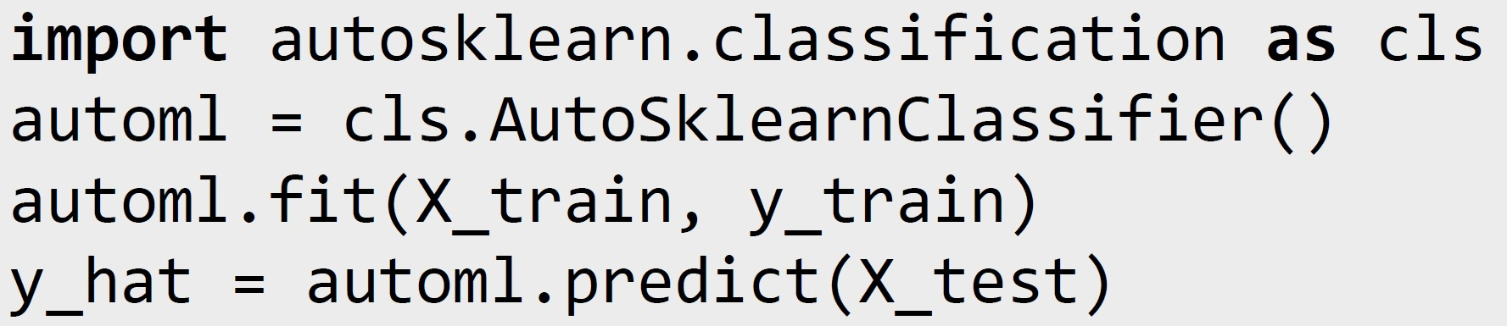
AutoML: Democratization of Machine Learning
Auto-sklearn also won the last two phases of the AutoML challenge human track (!)
It performed better than up to 130 teams of human experts
It is open-source (BSD) and trivial to use:
https://github.com/automl/auto-sklearn
→ Effective machine learning for everyone!

Slide 41
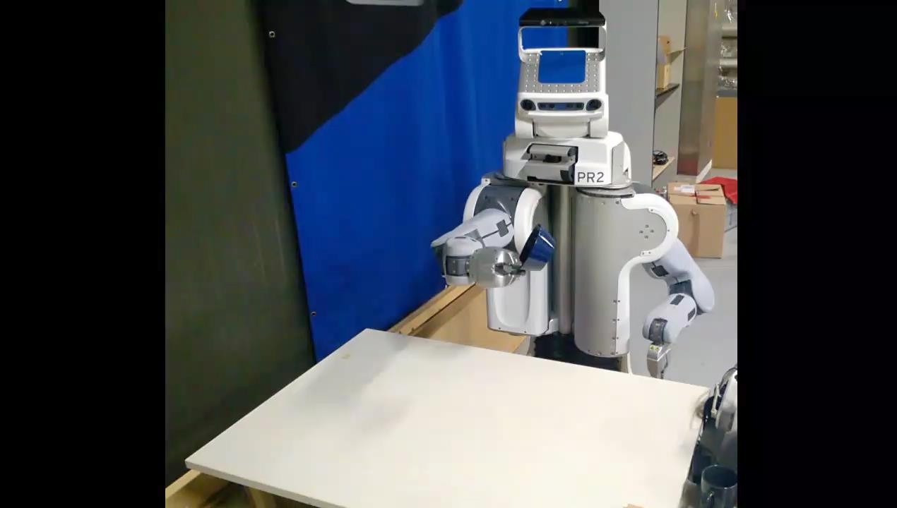
Example Application: Robotic Object Handling
Collaboration with
Freiburg’s robotics group
Binary classification task for object placement: will the object fall over?
Dataset
– 30000 data points
Video credit: Andreas Eitel
50 features -- manually defined [BSc thesis, Hauff 2015]
Performance
Caffe framework & BSc student for 3 months: 2% error rate
Auto-sklearn: 0.6% error rate (within 30 minutes)

Slide 42


Outline
https://zhuanlan.zhihu.com/p/43421202?fbclid=IwAR20wPOoNWoTVlbLMrm5TWkeZ3jpean_2LVmLa9QiUEdigDkxBj7ua3rQcw
1. Modern Hyperparameter Optimization
AutoML as Hyperparameter Optimization Blackbox Optimization
Beyond Blackbox Optimization
2. Neural Architecture Search
Search Space Design
Blackbox Optimization
Beyond Blackbox Optimization
Based on: Elsken, Metzen and Hutter [Neural Architecture Search: a Survey, arXiv 2018; also Chapter 3 of the AutoML book]

Slide 43
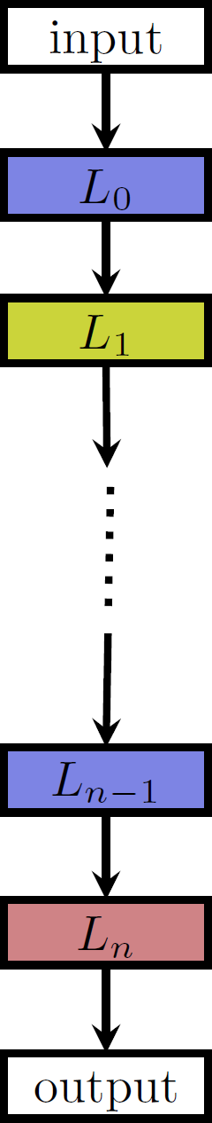
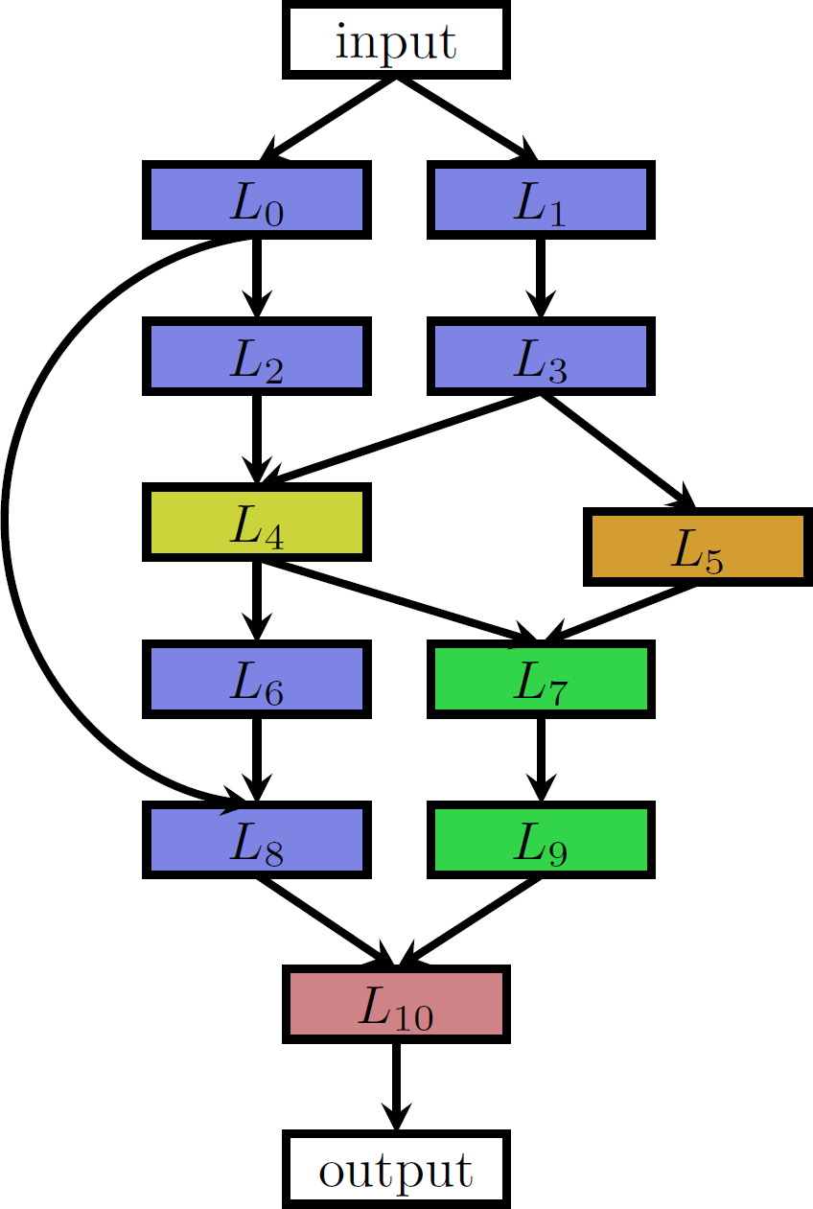
Basic Neural Architecture Search Spaces
Chain-structured space (different colours: different layer types)
More complex space with multiple branches and skip connections

Slide 44
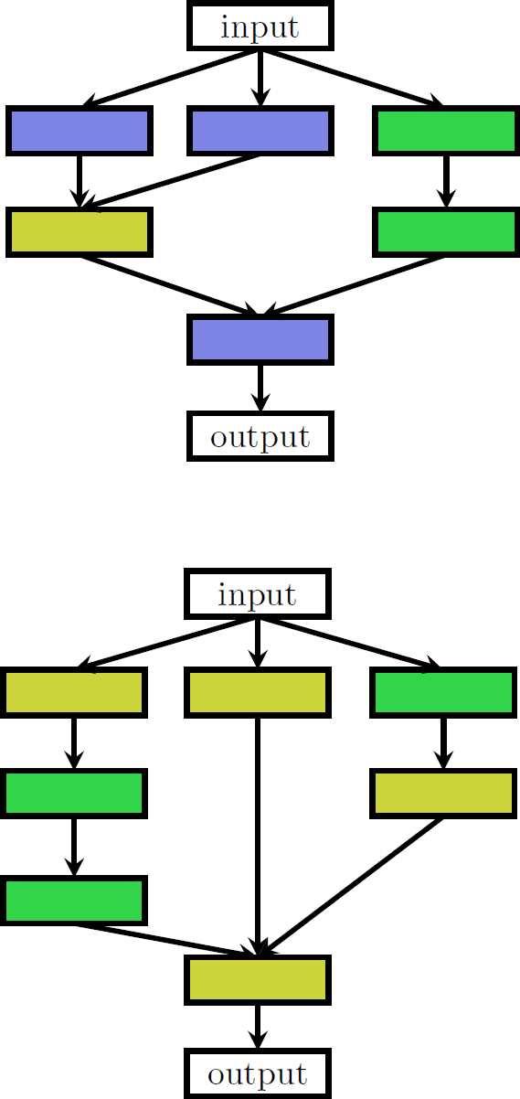
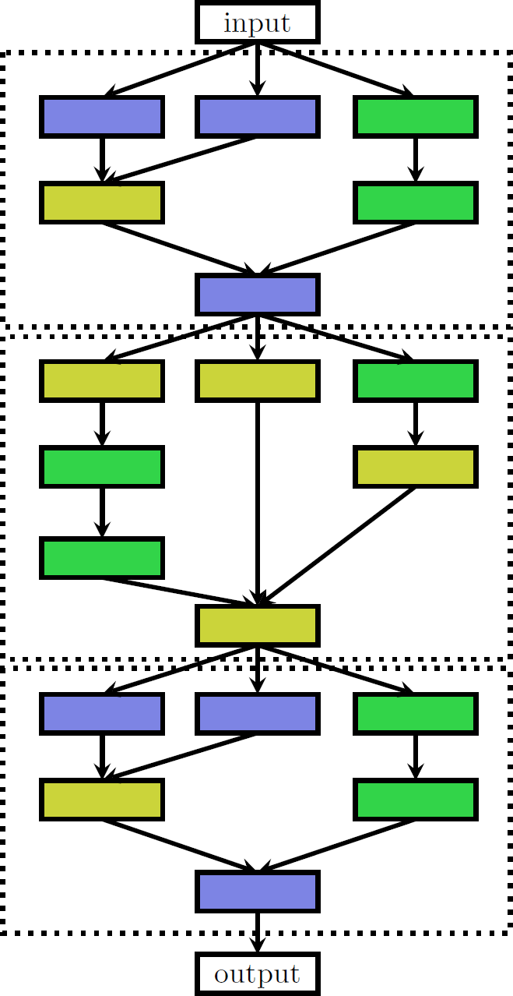
Cell Search Spaces
Introduced by Zoph et al [CVPR 2018]
Two possible cells
Architecture composed of stacking together individual cells
42

Slide 45
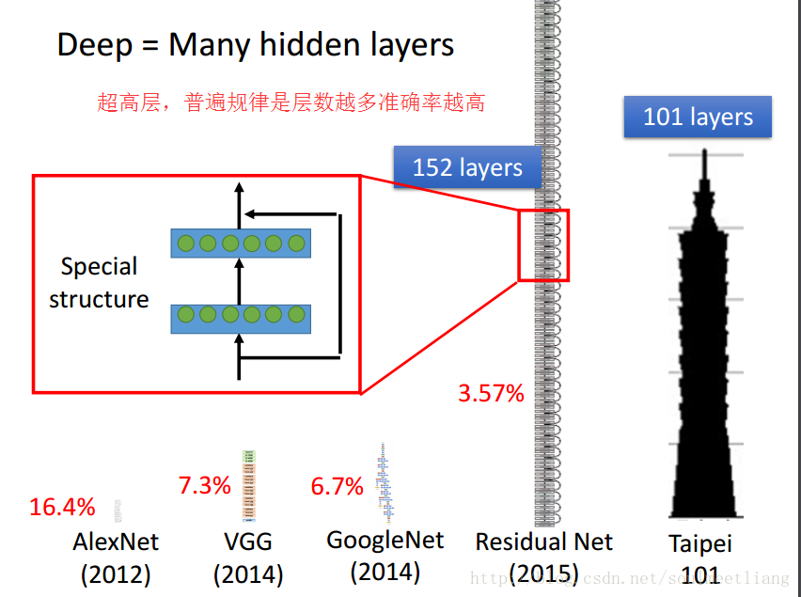
Residual Networks (ResNets)

Slide 46
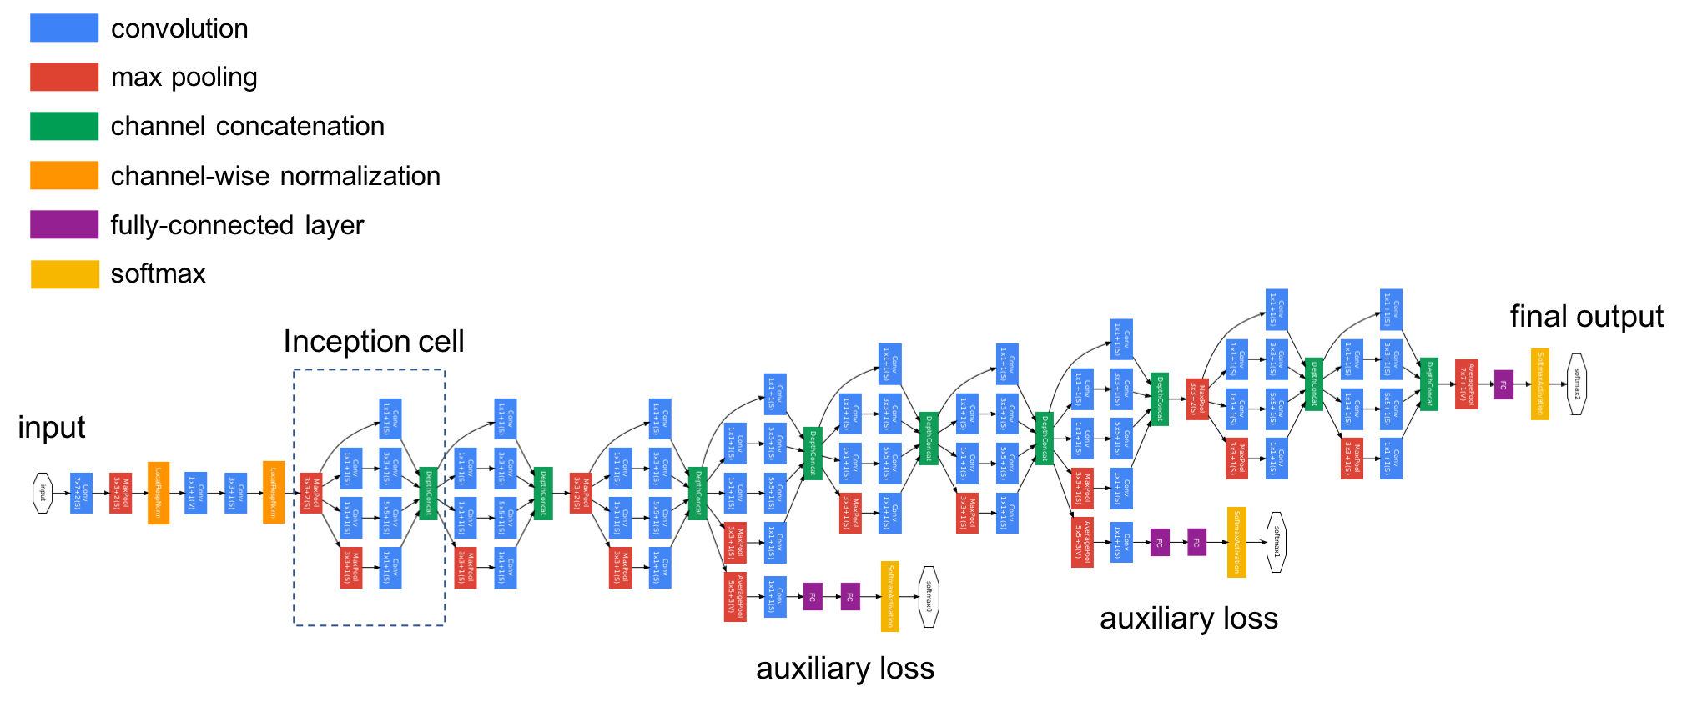
Inception Networks

Slide 47
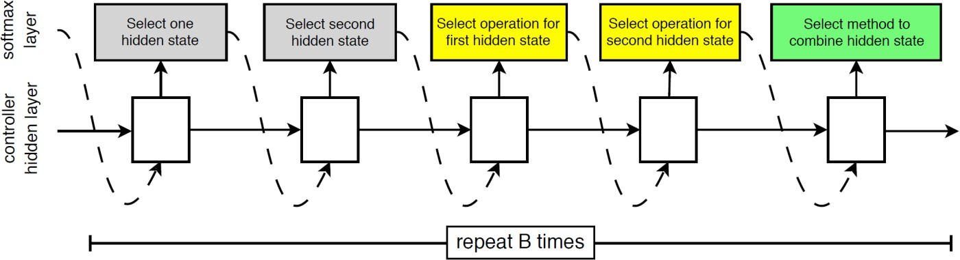
NAS as Hyperparameter Optimization
Cell search space by Zoph et al [CVPR 2018]
– 5 categorical choices for Nth block:
2 categorical choices of hidden states, each with domain {0, ..., N-1}
2 categorical choices of operations
1 categorical choice of combination method
→ Total number of hyperparameters for the cell: 5B (with B=5 by default)
Unrestricted search space
Possible with conditional hyperparameters
(but only up to a prespecified maximum number of layers)
Example: chain-structured search space
Top-level hyperparameter: number of layers L Hyperparameters of layer k conditional on L >= k

Slide 48
Outline
1. Modern Hyperparameter Optimization
AutoML as Hyperparameter Optimization Blackbox Optimization
Beyond Blackbox Optimization
2. Neural Architecture Search
Blackbox Optimization
Search Space Design
Beyond Blackbox Optimization

Slide 49
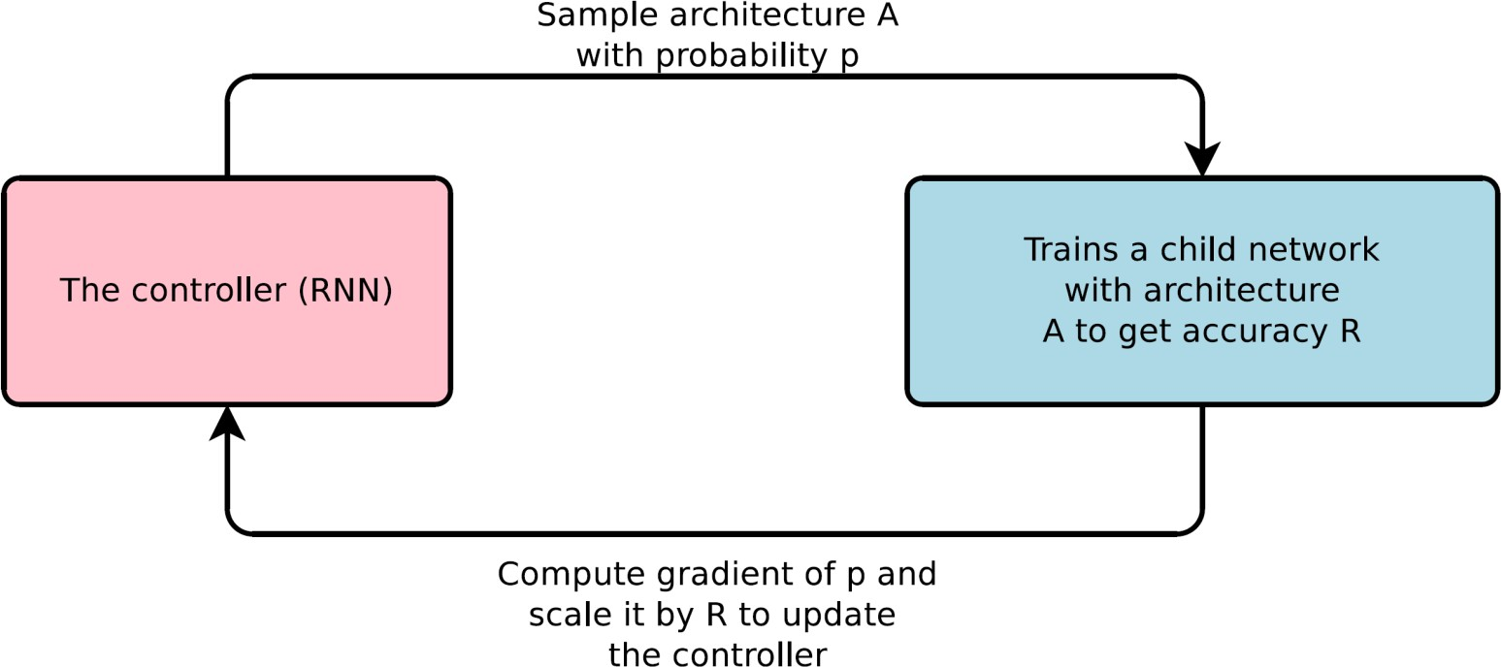
Reinforcement Learning
NAS with Reinforcement Learning [Zoph & Le, ICLR 2017]
State-of-the-art results for CIFAR-10, Penn Treebank
Large computational demands
800 GPUs for 3-4 weeks, 12.800 architectures evaluated

Slide 50
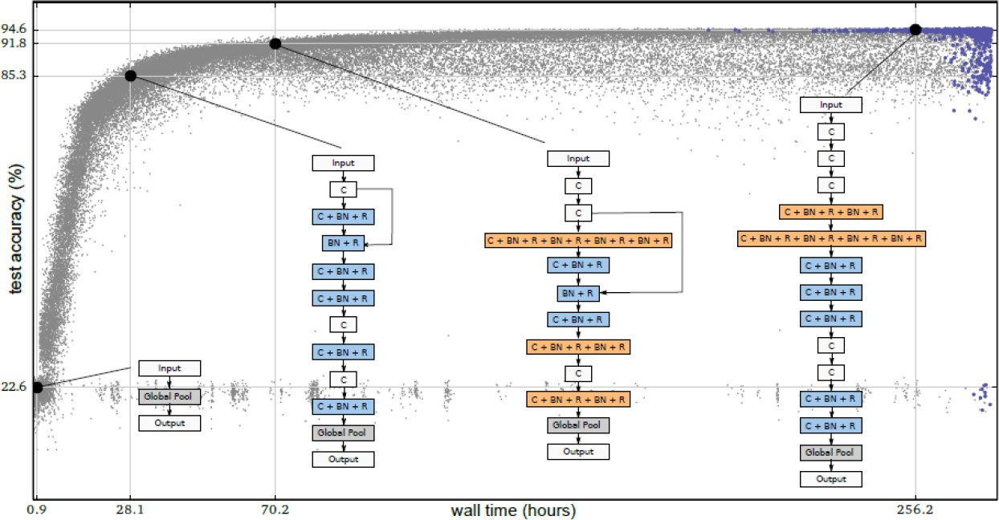
Evolution
Neuroevolution (already since the 1990s)
Typically optimized both architecture and weights with evolutionary methods
[e.g., Angeline et al, 1994; Stanley and Miikkulainen, 2002]
Mutation steps, such as adding, changing or removing a layer [Real et al, ICML 2017; Miikkulainen et al, arXiv 2017]

Slide 51
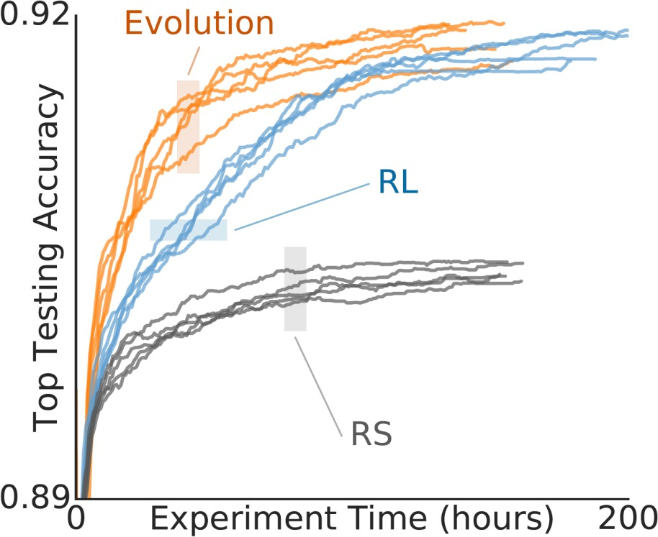
Regularized / Aging Evolution
Standard evolutionary algorithm [Real et al, AAAI 2019]
But oldest solutions are dropped from the population (even the best)
State-of-the-art results (CIFAR-10, ImageNet)
Fixed-length cell search space
Comparison of
evolution,
RL and random search

Slide 52

Genetic Algorithm
選擇人口、交配、變異
直到滿足最終條件

Slide 53

Genetic Algorithm v.s. Evolution Strategy
基因演算法
進化策略

Slide 54




Genetic Algorithm v.s. Evolution Strategy
。基因演算法 進化策略
0 1023
0 159
31 31
同 | 選擇人口、交配、變異，直到滿足最終條件 在程式裡生寶寶，殺死壞寶寶，讓乖寶寶繼續生寶寶
異 | 繁殖：選好的父母進行繁殖 編碼DNA：通常使用二進位制 變異DNA：透過隨機讓1變成0 | 先繁殖，再選好的孩子 通常是數值，如8.7 透過常態分佈(Normal distribution)

Slide 55
Bayesian Optimization
https://zhuanlan.zhihu.com/p/43421202?fbclid=IwAR20wPOoNWoTVlbLMrm5TWkeZ3jpean_2LVmLa9QiUEdigDkxBj7ua3rQcw
Joint optimization of a vision architecture with
238 hyperparameters with TPE [Bergstra et al, ICML 2013]
Auto-Net
Joint architecture and hyperparameter search with SMAC
First Auto-DL system to win a competition dataset against human experts [Mendoza et al, AutoML 2016]
Kernels for GP-based NAS
Arc kernel [Swersky et al, BayesOpt 2013]
NASBOT [Kandasamy et al, NIPS 2018]
Sequential model-based optimization
PNAS [Liu et al, ECCV 2018]

Slide 56
Outline
1. Modern Hyperparameter Optimization
AutoML as Hyperparameter Optimization Blackbox Optimization
Beyond Blackbox Optimization
2. Neural Architecture Search
Search Space Design
Blackbox Optimization
Beyond Blackbox Optimization

Slide 57
Main approaches for making NAS efficient
Weight inheritance & network morphisms
Weight sharing & one-shot models Multi-fidelity optimization
[Zela et al, AutoML 2018, Runge et al, MetaLearn 2018]
Meta-learning [Wong et al, NIPS 2018]

Slide 58


Network morphisms
Network morphisms [Chen et al, 2016; Wei et al, 2016; Cai et al, 2017]
– Change the network structure, but not the modelled function
I.e., for every input the network yields the same output
as before applying the network morphism
– Allow efficient moves in architecture space
恆等函數 (Identity mapping)

Slide 59

Weight inheritance & network morphisms
[Cai et al, AAAI 2018; Elsken et al, MetaLearn 2017; Cortes et al, ICML 2017; Cai et al, ICML 2018]
→ enables efficient architecture search

Slide 60


Weight Sharing & One-shot Models
Convolutional Neural Fabrics [Saxena & Verbeek, NIPS 2016]
Embed an exponentially large number of architectures
Each path through the fabric is an architecture
Figure: Fabrics embedding two 7-layer CNNs (red, green).
Feature map sizes of the CNN layers are given by height.

Slide 61
Weight Sharing & One-shot Models
Convolutional Neural Fabrics [Saxena & Verbeek, NIPS 2016]
Embed an exponentially large number of architectures
Each path through the fabric is an architecture
Figure: Fabrics embedding two 7-layer CNNs (red, green).
Feature map sizes of the CNN layers are given by height.

Slide 62

The idea is kind of similar to dropout

Slide 63

Weight Sharing & One-shot Models
Simplifying One-Shot Architecture Search
[Bender et al, ICML 2018]
Use path dropout to make sure the individual models perform well
by themselves
ENAS [Pham et al, ICML 2018]
Use RL to sample paths (=architectures) from one-shot model
SMASH [Brock et al, MetaLearn 2017]
Train hypernetwork that generates weights of models

Slide 64

DARTS: Differentiable Neural Architecture Search
[Liu et al, Simonyan, Yang, arXiv 2018]
Relax the discrete NAS problem
One-shot model with continuous architecture weight α for each operator
Use a similar approach as Luketina et al [ICML’16] to interleave
optimization steps of α (using validation error) and network weights

Slide 65
Some Promising Work Under Review
Anonymous ICLR submissions based on DARTS
SNAS: Use Gumbel softmax on architecture weights α [link]
Single shot NAS: use L1 penalty to sparsify architecture [link]
Proxyless NAS: (PyramidNet-based) memory-efficient variant of DARTS that trains sparse architectures only [link]
Graph hypernetworks for NAS [Anonymous ICLR submission]
Multi-objective NAS
MNasNet: scalarization [Tan et al, arXiv 2018]
LEMONADE: evolution & (approximate) network morphisms [Anonymous ICLR submission]

Slide 66
Remarks on Experimentation in NAS
Final results are often incomparable due to
Different training pipelines without available source code
Releasing the final architecture does not help for comparisons
Different hyperparameter choices
Very different hyperparameters for training and final evaluation
Different search spaces / initial models
Starting from random or from PyramidNet?
→ Need for looking beyond the error numbers on CIFAR
→ Need for benchmarks including training pipeline & hyperparams
Experiments are often very expensive
→ Need for cheap benchmarks that allow for many runs

Slide 67
HPO and NAS Wrapup
Exciting research fields, lots of progress
Several ways to speed up blackbox optimization
Multi-fidelity approaches
Hyperparameter gradient descent
Weight inheritance
Weight sharing & hypernetworks
More details in AutoML book: automl.org/book
Advertisement: we‘re building up an Auto-DL team
Building research library of building blocks for efficient NAS
Building open-source framework Auto-PyTorch
We have several openings on all levels
(postdocs, PhD students, research engineers); see automl.org/jobs

Slide 68
AutoML and Job Loss Through Automation
Concern about too much automation, job loss
AutoML will allow humans to become more productive
Thus, it will eventually reduce the work left for data scientists
But it will also help many domain scientists use machine learning that would otherwise not have used it
This creates more demand for interesting and creative work
Call to arms: let‘s use AutoML to create and improve jobs
If you can think of a business opportunity that‘s made feasible by AutoML (robust, off-the-shelf, effective ML), now is a good time to act on it ...

Slide 69
AutoML: Further Benefits and Concerns
+ Democratization of data science
+ We directly have a strong baseline
+ We can codify best practices
+ Reducing the tedious part of our work,
freeing time to focus on problems humans do best (creativity, interpretation, …)
− People will use it without understanding anything

